Slide 1
Smart traffic lights
Ghassan Haddadin 20190410
Issam Al-samardali 20200541
Zeina Haddadin 20190238

Slide 2
introduction
This project aims to reduce traffic congestion, improve the road experience, and save a lot of time wasted on the road. This will also increase the efficiency of the public transport system which will further contribute to resolving the issue. Also, this solution will have an effect on the medical and public safety sectors by prioritizing the lanes of ambulances and police vehicles.

Slide 3
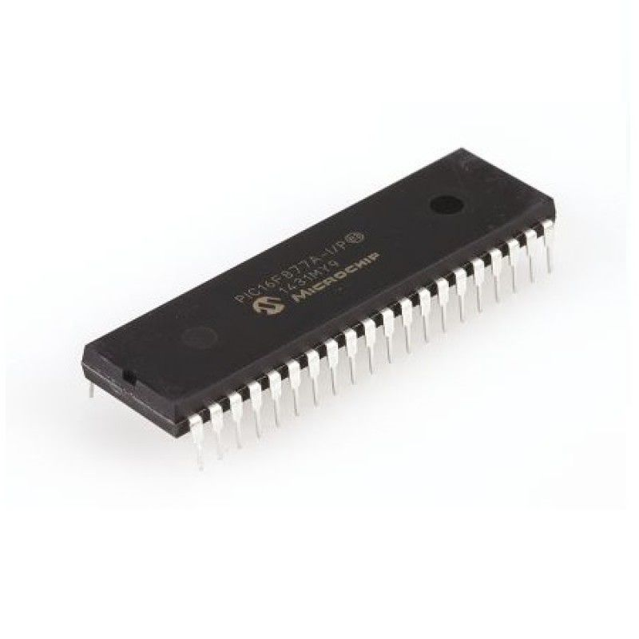
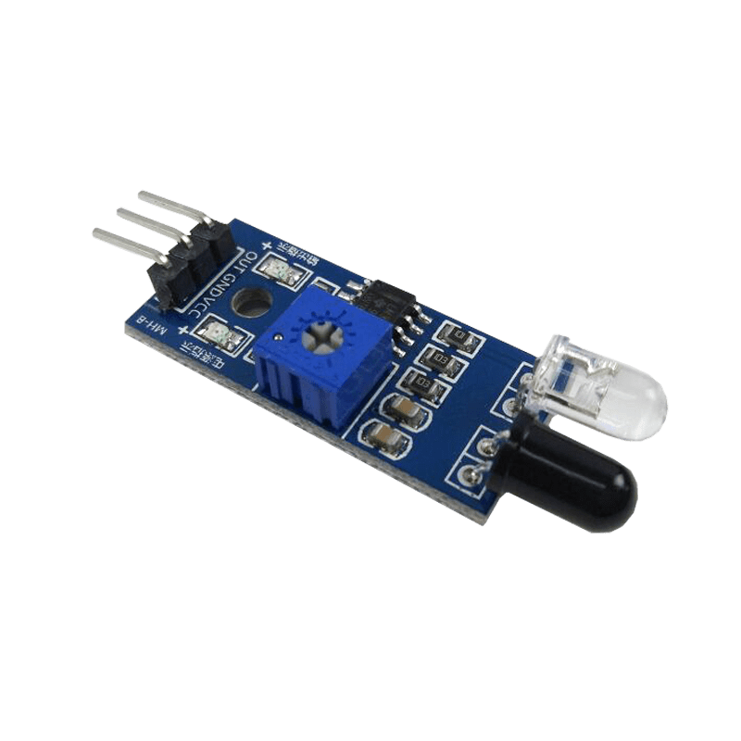
Components
1. PIC16F877A:
2. IR Sensors:

Slide 4
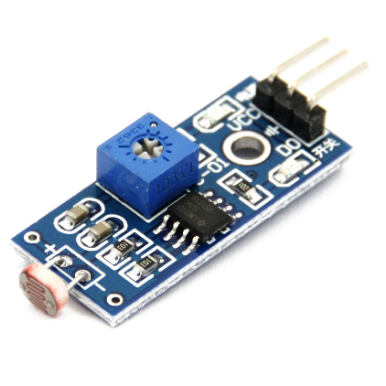
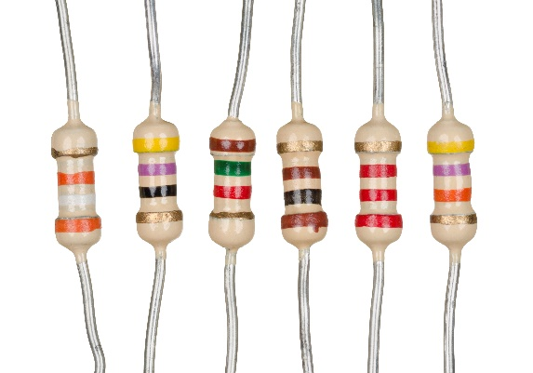
Components
3. Digital LDR:
4. Resistors:

Slide 5
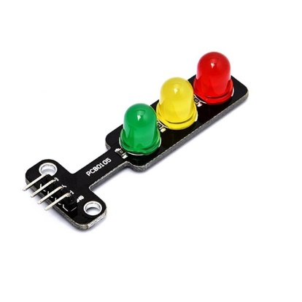
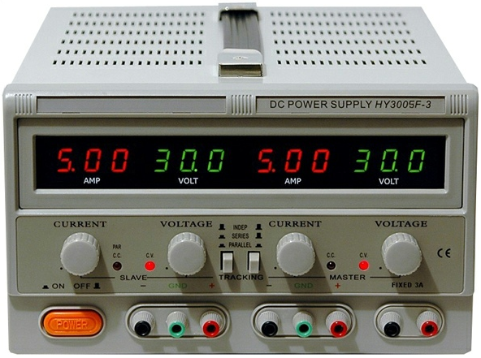
Components
5. Traffic Lights LEDs:
6. DC Power Supply:

Slide 6
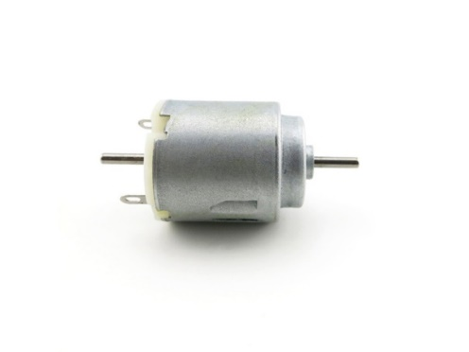
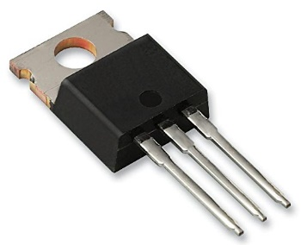
Components
7. NMOS Transistors:
8. DC Motors:

Slide 7
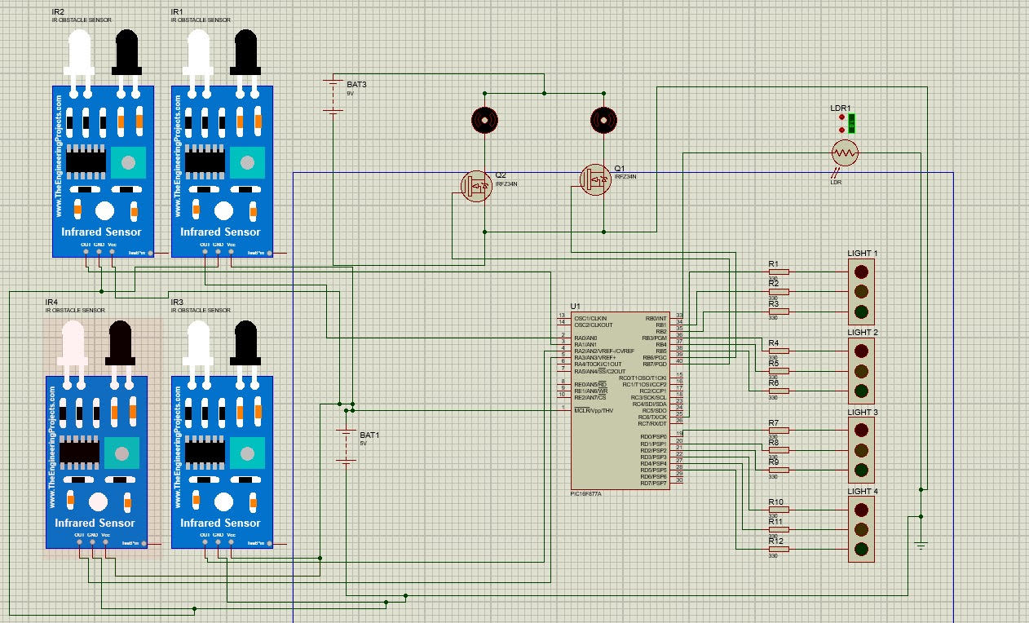
Schematic diagram

Slide 8
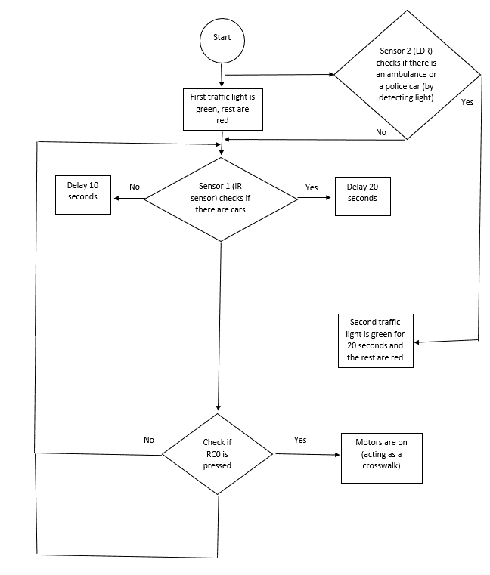
Flowchart

Slide 9
Problems & Recommendations
Problems:
1. We tried to use the color sensor TCS3200 to detect a blue flashing light coming from the ambulance, but the noise was very high and it couldn't detect it due to the varying frequency range for every color.
2. We replaced it with an LDR to detect the light of the ambulance or a police car.
3. One of the pins on the PIC was broken during the process.
4. The two DC motors acting as a crosswalk were difficult to place on the wood board.
Recommendations:
1. Use a sound sensor instead that is programmed to detect the sirens of the ambulance and/or police car.
2. Could try to use a more accurate color sensor with higher accuracy, and write a code for it with the correct frequency range for the color needed.
3. Replace the broken PIC with a new one.
4. Drill a hole for the motors on the board.

Slide 10
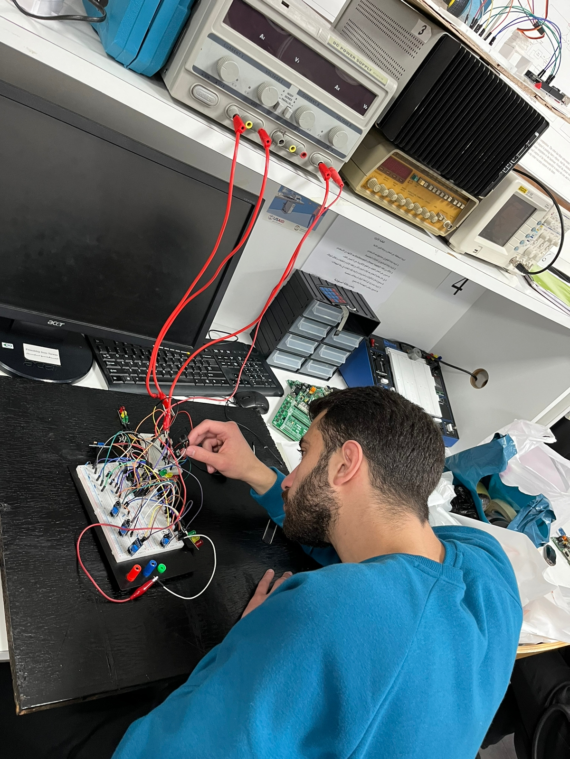
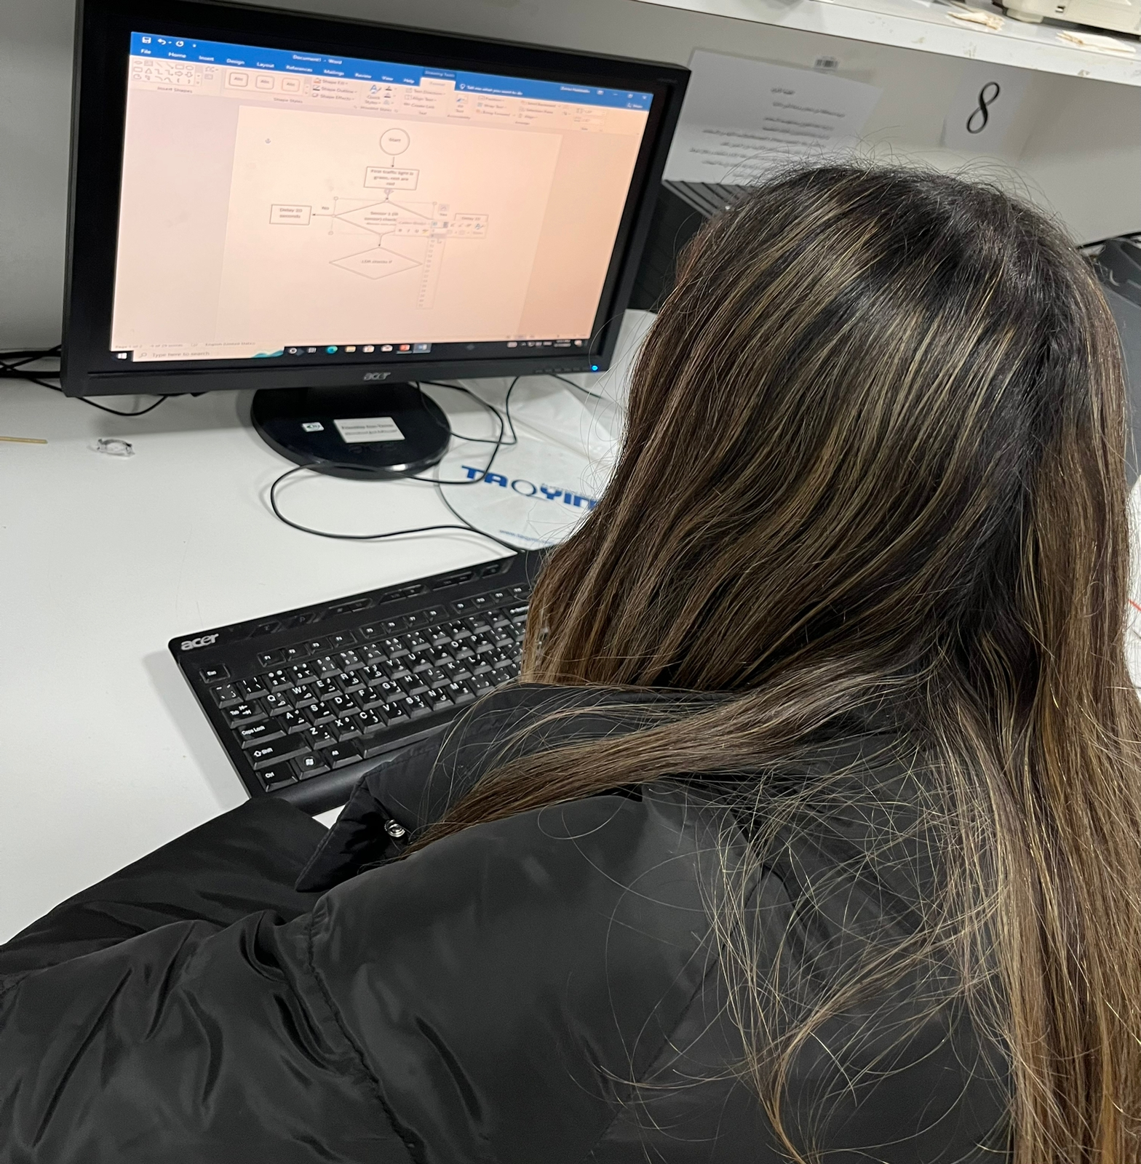
Procedure

Slide 11
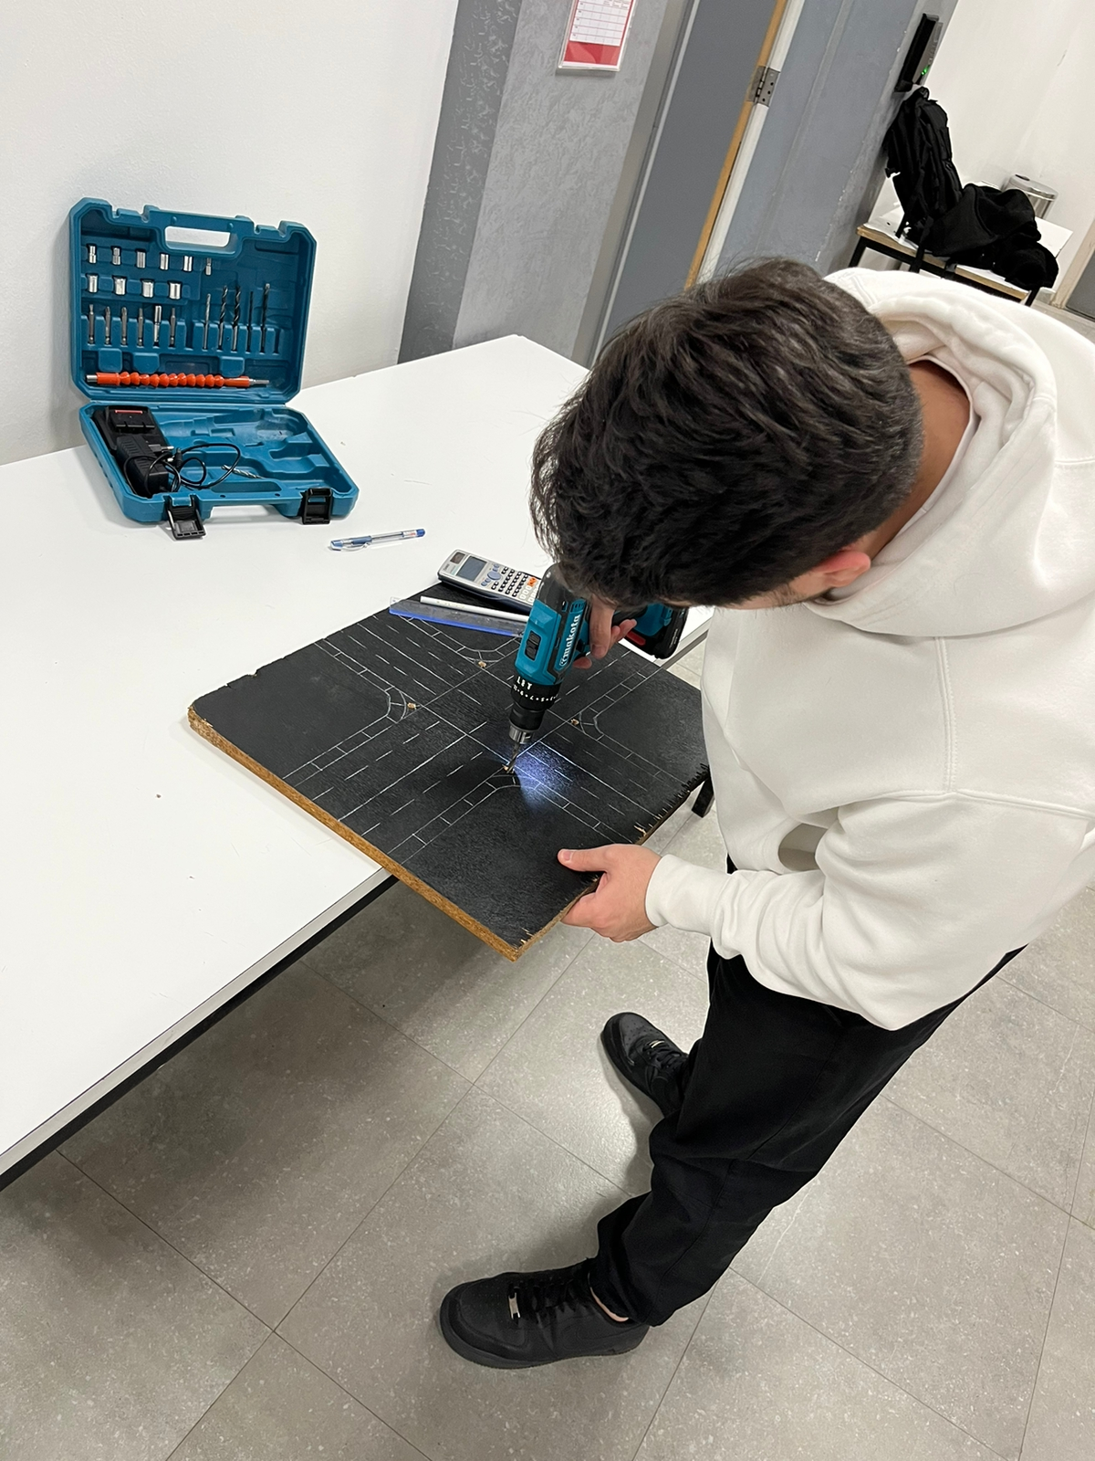
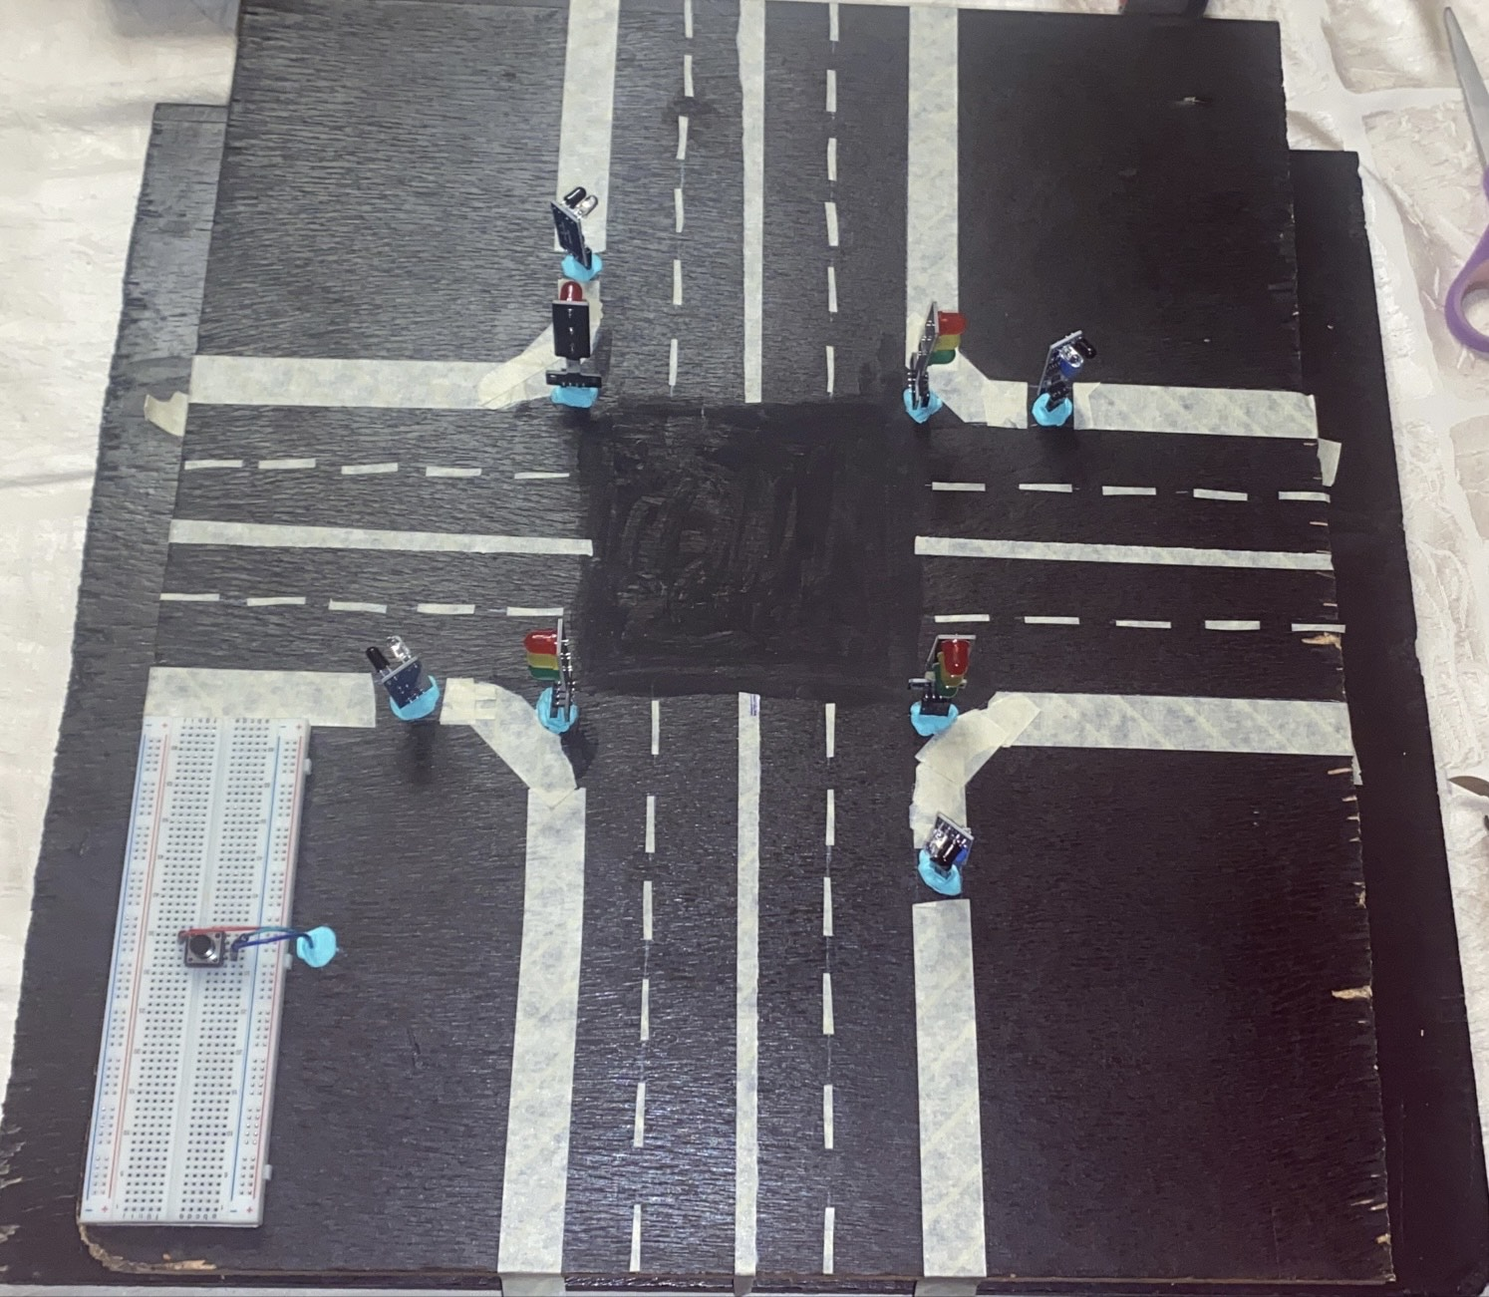
Procedure

Slide 12
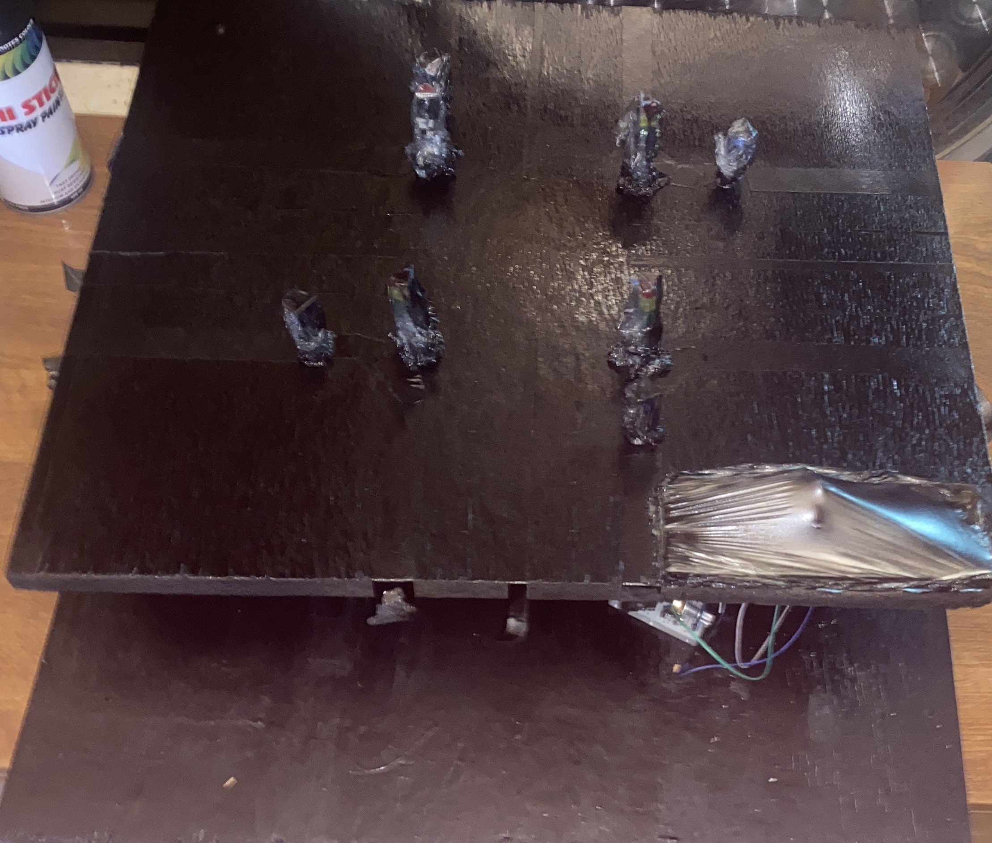
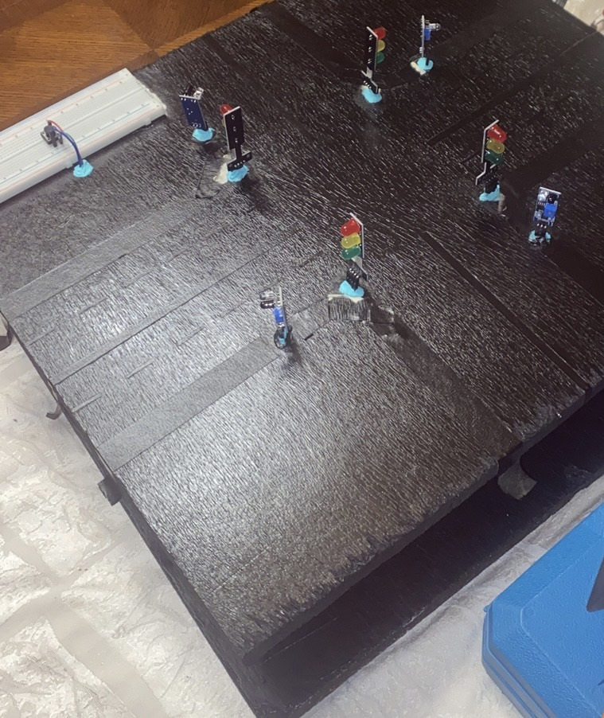
Procedure

Slide 13
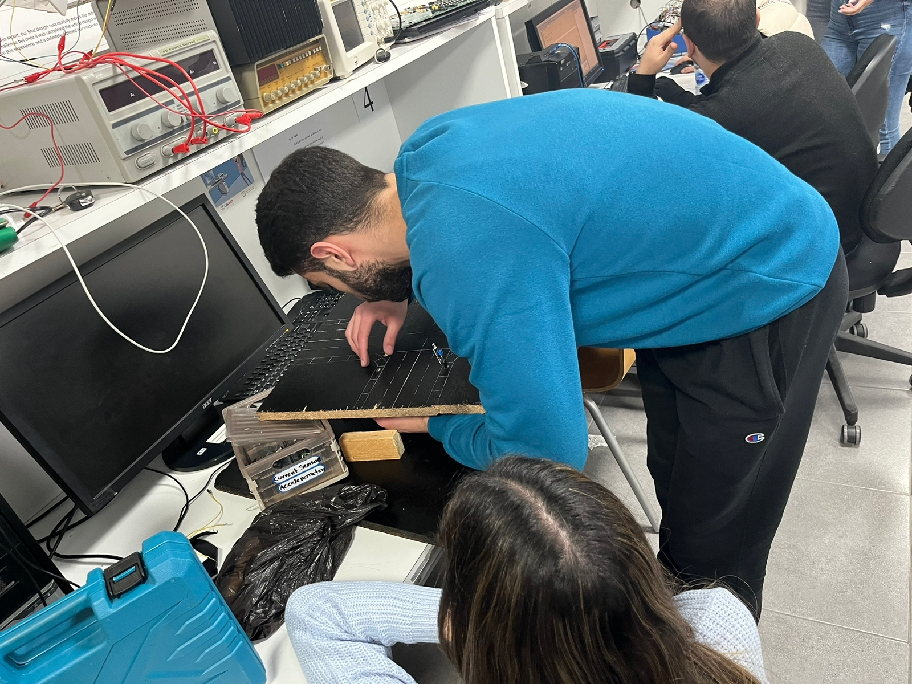
Procedure

Slide 14
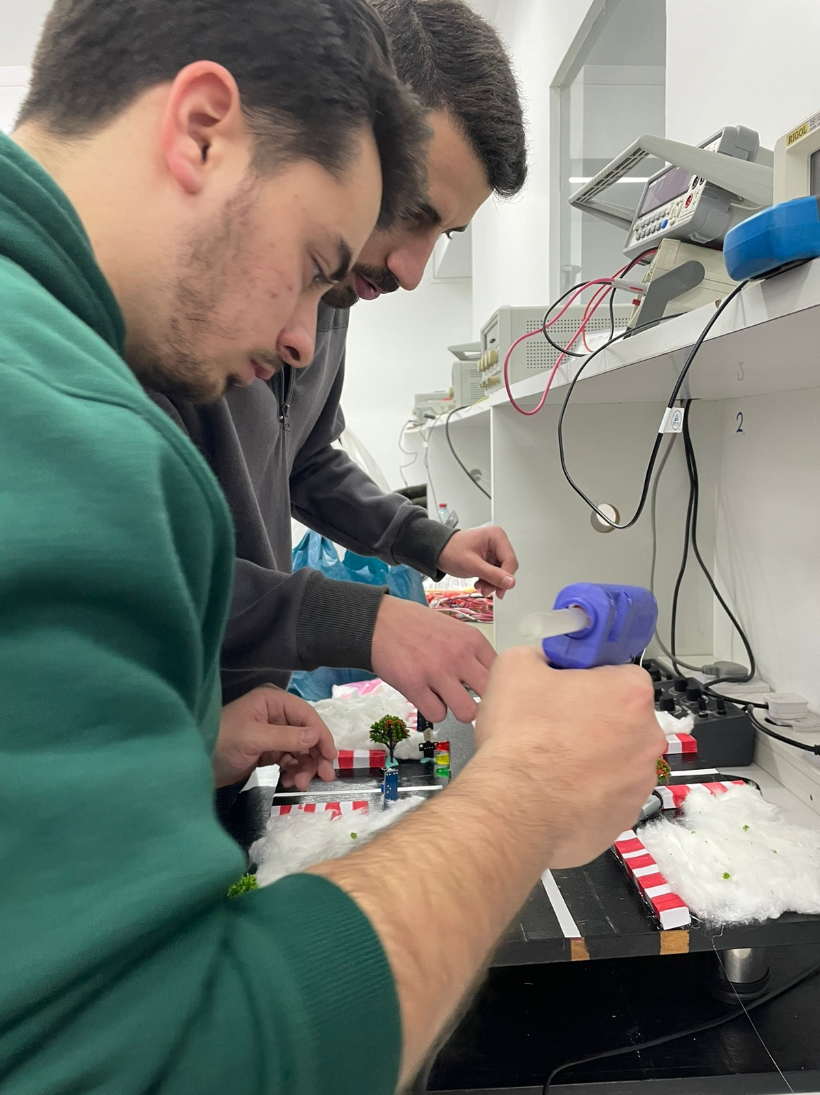
Procedure

Slide 15
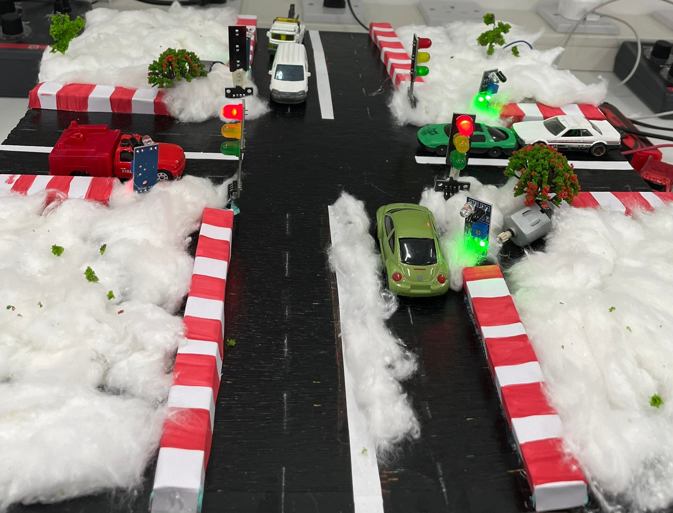
Results

Slide 16
conclusion
To conclude, the main purpose of our project is to help avoid congestion and traffic on the road by using IR sensors that detect objects to help speed up the process. A push button was used to help people cross the road safely and efficiently. Also, once there is an emergency, the ambulance or police car will be able to move faster as all other traffic lights on the road will be red except the one that detected the emergency lights, this will enable it to reach its destination on time without any delays. Such a system can be applied in cities like Amman to solve the problem of increased traffic that we have been facing recently due to our growing population.

Slide 17
Thank you!

